Slide 1

AI & ML in Front-End
backend not included
By Igor Larionov @ PVH Europe
Notes:
Hi, today I would like to share with you an amusing world of Machine Learning and Artificial Intelligence in the frontend! Without need to use backend (or you can do both), just JavaScript, TypeScript and React! Exciting, right? We will talk about performance as well and some tweaks to it.

Slide 2
About myself
Igor Larionov
Front-end engineer @ PVH Europe
Github: https://github.com/cmpara/pvh-tech-talk-ai-fe
Notes:
Hi, my name is Igor Larionov, I am Front-end engineer at PVH Europe, that you have no idea about, although, you have seen many adds and probably you have heard about its brands and have bought its products… Calvin Klein, Tommy Hilfiger, fashion, clothes, shoes, this kind of stuff. I am mainly focused on our companies e-commerce platform for business-to-business digital sales. Everything I am going to talk about is also available at my github where you can find me by nickname cmpara (see-am-pah-rah). But don’t worry it’s not big, just one repo with this talk.

Slide 3
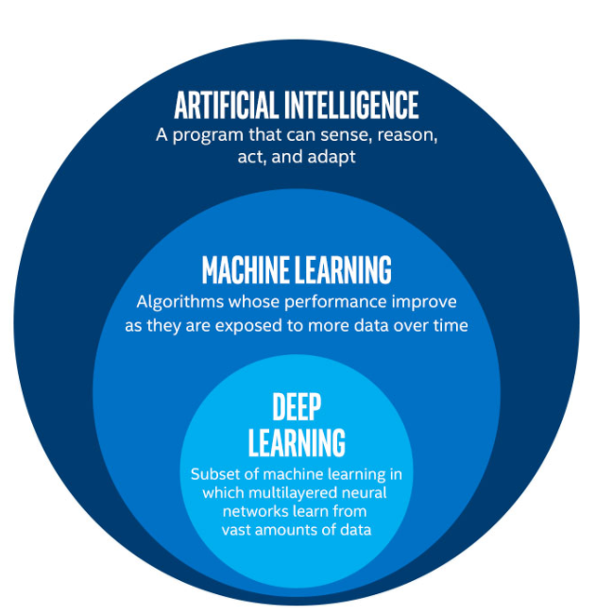
Machine Learning, Data Science, Artificial Inteligence
Data Science is a broad field of study about data systems and processes aimed at maintaining data sets and deriving meaning from them.
Artificial Inteligence is field of study focused on building systems that cen reason, leadn and solve problems mimicing human thought process.
Machine learning is a subsection of Artificial intelligence that devices mean by which systems can automatically learn and improve from experience.
Notes:
Data science, machine learning, and artificial intelligence are three related but distinct fields in computer science.
Data science is a broad field that involves the extraction, processing, analysis, and interpretation of large, complex datasets. It involves using statistical and computational methods to identify patterns and insights in data, and often involves the use of specialized tools and programming languages like Python and R.
Machine learning is a subset of data science that focuses on using algorithms and statistical models to allow computer systems to learn from data without being explicitly programmed. In other words, machine learning algorithms can improve their performance over time by identifying patterns in data and adjusting their behaviour accordingly. Machine learning is often used for tasks like image and speech recognition, natural language processing, and predictive modelling.
Artificial intelligence (AI) is a broader field that includes machine learning but also encompasses other techniques for creating intelligent machines. AI involves building systems that can reason, learn, and solve problems in ways that mimic human thought processes. This can include tasks like planning, decision-making, and natural language understanding. AI techniques can be used to create a wide range of applications, from self-driving cars to intelligent virtual assistants.
In summary, data science is the overall field of working with data, while machine learning is a subset of data science that involves building algorithms to learn from data. Artificial intelligence is a broader field that includes machine learning and involves creating intelligent systems that can reason, learn, and solve problems.

Slide 4
How to do AI & ML in Front-End
Traditional Server-Client approach (VM, on-Premises backend servers with/without GPU/TPU)
Cloud, AI as SaaS approach
Edge approach
Frontend-only approach
Notes:
There are many ways how to implement AI & ML in the Front-end.
The very first that comes to mind is to use a server that will receive data from Frontend and process it, the server may need GPU to accelerate the calculations or powerful CPUs or even special hardware optimized for machine learning training and inference like TPU (Tensor Processing Unit). This can be done using syncronous and asyncronous manner, utilizing streams to send data or receive output like in ChatGPT, or can be done as a server with a message queue and long polling in the FE to get results if takes a lot of time to process the data.
Another way is to rely on the cloud whether to deploy own ML backend to the cloud or just consume AI as a service that removes the part that requires you to manage own infrastructure and allows to scale better with the load or just rely on the cloud service. Good example is Google’s speech recognition API that allows you to send audio from frontend and then get the text from that audio back.
To improve on latency several companies started to use same technics as with CDN – edge computing, moving machines capable to run ML algorithms closer to consumer ”to the edge of network” and allowing to process data in decentralized way unlike traditional cloud centralized centers.
Lastly the approach we are focusing today – use your ML in the frontend directly and do not send data outside the device, but compute on device of the user, which can significantly improve security, privacy and latency

Slide 5
Why do AI&ML in Front-end
Overcome limits
Low latency
Privacy
Cross-Platform
Offline
Cost-reduction
“Small” models run fast
Notes:
But why should you do AI & ML in the frontend, won’t it be too slow? Well one reason is that many production-grade models are not that large exactly for the reason to optimize performance and reduce computation costs. Linear regression, decision trees, perceptrons and even some neural network architectures if optimized can occupy several megabytes instead of gigabytes and be very fast even on CPU.
While time, speed and complexity of AI in FE are its downsides there are advantages:
You can overcome limits if you don’t have a backend or ML in backend, or backend with GPU, you won’t need to worry on computation costs (if your BE in the cloud, or ML as a service) as all computation will be on the client device
As the data is extremely close to the model, there is no ping-pong between client and server, you can reduce latency and avoid time spent on domain name resolution, ssl certificate verification, TCP connection challengehandshakes and actual data transfer to and from the BE.
If the model has to work with sensitive data like medical scans, health information or other personal information (like reading your credit card details from the image to fill in the payment form or verifing your ID for carsharing) it is better to do such job on device, so that data is not sent out and possibly compromised
Cross platform – all computation is done on device in the browser, although only most recent (and in some cases only Chromium browsers) fully support libraries that enable AI in the frontend, you are not dependant on OS limitations or type of CPU (as long as it is 32 or 64bit, RISC or CISC) and may use GPU if available. No need to create platform/device specific AI models (like coreML, tenforflowLite).
Offline: if you want to enable support for offline use of AI features in your PWA that is possibile, as your models will live in the frontend and not on the server so no network calls are needed and thus offline mode is fully supported
Cost reduction – no need to pay as you go for computational power in the cloud or maintainance of own infrastructure or service subscriptions. All computation is on the device of the user (free! Except the electricity bill to charge the device)
There is a limit of RAM that also limits the model size but it is pretty big – 4GB (so 1GB models can easily fit, and NanoGPT for instance is around 130mb)

Slide 6
What to do with AI & ML
Classification
Regression
Clustering
Recommendation
Anomaly detection
NLP
Speech-to-text, text-to-speech
Computer Vision
Chatbots
Notes:
But what tasks can you automate using AI.
NLP : spelling correction, text generation, text analysis, machine translation, etc
Computer vision: Image detection, segmentation, text-to-image, image-to-text

Slide 7
What libraries/frameworks are available for frontend
Browser API for barcode, QR code, face recognition, ASR and so on
Tensorflow.js
ONNX Runtime Web
Other libraries: Synaptics, Brain.js, ML5.js, Neuro.js
GPU hardware acceleration (WebGL, WASM, WebGPU API)
Notes:
Main advantage comes with GPU acceleration from the device (with CPU fallback) via WebGL and WebGPU API (or WebAssembly)

Slide 8
Browser API that uses AI
BarcodeDetector (and QR-code) (Experimental)
Speech Recognition (Speech-To-Text)
Speech Synthesis (Text-To-Speech)
Chrome Face Detection API (only in Chrome-based browsers)
Notes:
Some of the AI algorithms are available in browser API, for example Barcode Detector (also for QR code) can detect part of the image where there is a barcode or QR-code and read it, although the feature is still experimental and it is not supported by all browsers
Speech recognition or speech-to-text and speech synthesis (text-to-speech) works pretty well with English language and is used by screen readers but also you can use that Browser API on the site
Chromium browsers

Slide 9

Demo time

Slide 10
Tensorflow.js (Tensorflow and Keras models)
Tensorflow is cross-platform deep learning neural network framework that supports many languages (C, Python, JavaScript, etc)
Convert Python models to JavaScript for use in Frontend
Build and train models in Browser or Node
hardware GPU acceleration can be done by one of the supported methods: WebGL, WASM, Web GPU or fall back to CPU

Slide 11
Demo time

Slide 12
ONNX.js -> ONNX Runtime Web
ONNX Runtime Web is a Javascript library for running ONNX models on browsers and on Node.js.
ONNX Runtime Web has adopted WebAssembly and WebGL technologies for providing an optimized ONNX model inference runtime for both CPUs and GPUs.
The Open Neural Network Exchange (ONNX) is an open standard for representing machine learning models. The biggest advantage of ONNX is that it allows interoperability across different open source AI frameworks, which itself offers more flexibility for AI frameworks adoption.
Only Inference (prediction) is supported but with lots of performance optimizations
Train model in Python (Pytorch/Tensorflow/CNTK) and export it to ONNX format, then use with ONNX Runtime Web

Slide 13
Demo time

Slide 14
Webshop use cases
Semantic search
Recommendations
Similar items
QR-code/Barcode readers
AR/VR
Predictive analytics
Chatbots for customer support/sales
Notes:
AR/VR – display clothes on yourself (photo/video) or 3D avatar (showroom)

Slide 15
Challenges
data privacy concerns
model accuracy
computation power requirements

Slide 16
Future of AI and ML in Frontend
Further development of experimental AI features that become part of normal Web API like WebGPU
More devices will support GPU/AI hardware acceleration
More adoption of AI/ML libraries in Frontend for use without Backend serving models
Development of current Frontend libraries and frameworks also dissolve the border between Backend and Frontend: Server Side Rendering and components making it easier to integrate AI and ML in the Frontend

Slide 17
Links
https://www.tensorflow.org/js
https://onnxruntime.ai/docs/get-started/with-javascript.html
https://ml5js.org/
https://brain.js.org/
https://caza.la/synaptic/#/
https://neuro.js.org/

Slide 18

Questions

